Slide 1
OHV (Over Head Vehicle) SYSTEM PROPOSAL
GSI ‘19年
Oct 14 , 2019
GSI Co., Ltd.

Slide 2
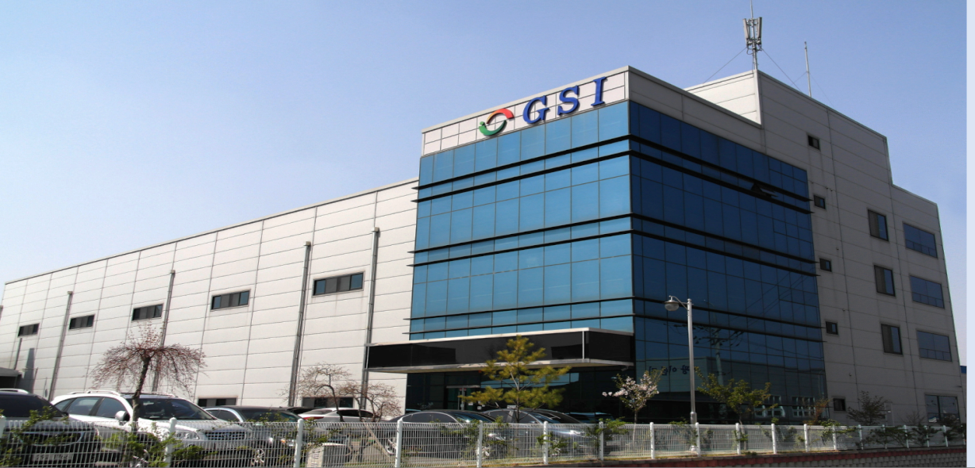
CONTENTS
Revision Sheet
General Description
1. System Overview
1-1. System Overview
1-2. Vehicle Route & Cycle Time
2. System Configuration
2-1. OHV System Configuration
2-2. Maintenance Lifter
2-3. Work Lifter & Work Shuttle
2-4. Data Matrix Positioning System
2-5. Charging Station & Collector
2-6. Power Supply Unit (Battery)
2-7. On-Line System
3. Utility Specification

Slide 3
REVISION SHEET
REV. No. | 주요 변경 내역 | DATE
0 | ▶ 초안작성 | 2019. 09. 17
1 | ▶ Lay Out 변경 | 2019. 10. 07
2 | ▶ Lay Out 변경 | 2019. 10. 14
■ Equipment Name : OHV SYSTEM
■ Customer’s Reference No. :
■ Manufacturing No. :
■ Rev. No. : REV. 2
■ Issued No. : 190917
■ Customer (Approval)
Received by : Date : / / .
Authorized by : Date : / / .

Slide 4
GENERAL DESCRIPTION
1-1. SYSTEM OVERVIEW
No | DESCRIPTION | SPECIFICATION | REMARK
1 | Application Process | OHV (Overhead Vehicle) System
2 | Work Spec. | 자재 Box ( 850(L) x 650(W) x 500(H) )
3 | Pass Line | Pass Line : 2134.5mm (천정으로부터 1,000mm 내 구성) | 천정고 : 3M
4 | Configuration | 1) Rail : Closed Loop R_190m / L_210m (Straight, Curve, Branch & Safety Fence)
 |  | 2) Vehicle Quantity : Total 8 Set -. Right Rail : 4 Set (Operation 3 Set / Charging 1 Set) -. Left Rail : 3 Set (Operation 2 Set / Charging 1 Set) -. Spare : 1 Set
 |  | 3) Ports ( Work Lifter ) : Total 14 Set -. Right Rail : 8 Set -. Left Rail : 6 Set
 |  | 4) Vehicle Maintenance Lifter ( MTL ) : Right 1 Set, Left 1 Set
 |  | 5) Maintenance Branch : Right 2 Set, Left 2 Set
 |  | 6) Charging Station : Right 1 Set, Left 1 Set - Battery Power Supply Only ※ 지정된 충전위치 외에 Vehicle 대기 위치 상에서 수시 충전
5 | Vehicle Power Supply | Battery Power Supply Type – 별도의 Charging Station 및 충전 대기 Vehicle 필요
6 | Shuttle (Vehicle) Driving Speed | Straight : Max. 180m/min (3,000mm/sec)
 |  | Curve : Max 35m/min (583mm/sec)
 |  | Acceleration (Deceleration) : 1m/sec2 (0.1G)
7 | Control | MTL, Vehicle & Work Lifter : PLC Sequence Control
 |  | OCS, CIM : PC Control
 |  | Vehicle to Main Controller (PLC) Communication : Wireless Wifi
 |  | OCS to Main Controller (PLC) Communication : CC Link IE

Slide 5
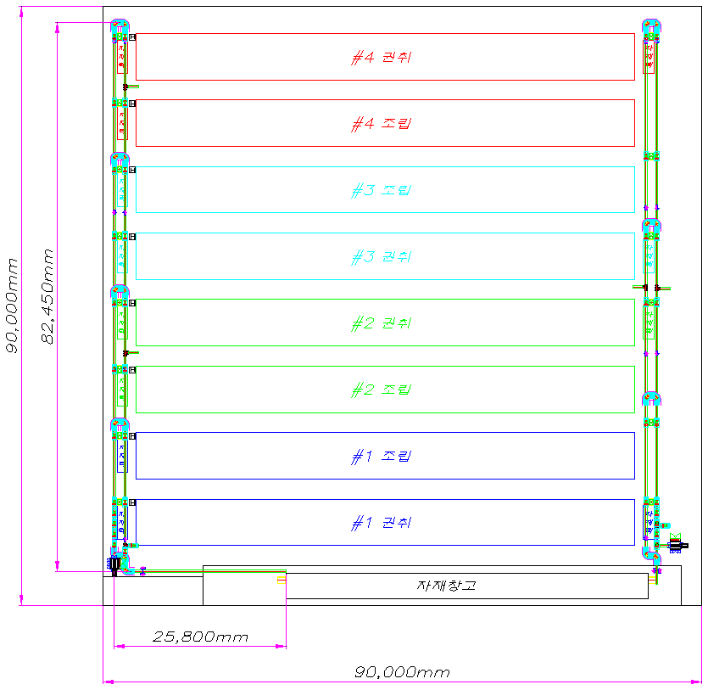
GENERAL DESCRIPTION
1-2. VEHICLE ROUTE & CYCLE TIME
■ VEHICLE ROUTE
VEHICLE DRIVING SPEED
-. Straight Driving Speed :
Max 180m/min (3000mm/sec)
-. Curve Driving Speed :
Max 35m/min (580mm/sec)
-. Acceleration (Deceleration) Speed : 1m/sec²

Slide 6
GENERAL DESCRIPTION
1-2. VEHICLE ROUTE & CYCLE TIME
■ VEHICLE CYCLE TIME & VEHICLE 필요수량
항목 |  |  |  |  | 자재교체주기 (Hr) | 자재필요 (Min) | 자재필요횟수 (1Day) | OHV 수량 -. 1Loop이송=4Min기준(Hr가능=15회) -. 1Day=360회 (가동 율 100%) -. 1Day=241.2회 (가동 율 67%) | 비고
Right 권취 + CAN | 권취 (1) | 1 | TAB(4) | 1 | 6.9 | 414 | 3.5 |  | 241.2
 |  |  |  | 2 | 6.1 | 366 | 3.9
 |  |  |  | 3 | 7.8 | 468 | 3.1
 |  |  |  | 4 | 11.4 | 684 | 2.1
 |  | 2 | TAB(6) | 1 | 6.9 | 414 | 3.5
 |  |  |  | 2 | 9.9 | 594 | 2.4
 |  |  |  | 3 | 7.7 | 462 | 3.1
 |  |  |  | 4 | 12.6 | 756 | 1.9
 |  |  |  | 5 | 34.1 | 2046 | 0.7
 |  |  |  | 6 | 11.4 | 684 | 2.1
 |  | 3 | SEPARATOR |  | 1.1 | 66 | 21.8
 | 조립 | 4 | CAN |  | 0.2 | 12 | 120.0 |  | CAN
 | 권취 합계(4대기준) |  |  |  |  |  | 672.6 | 2.8 | OHV수량=3대
Left 권취 + 조립 | 권취 (1) | 1 | TAB(4) | 1 | 6.9 | 414 | 3.5
 |  |  |  | 2 | 6.1 | 366 | 3.9
 |  |  |  | 3 | 7.8 | 468 | 3.1
 |  |  |  | 4 | 11.4 | 684 | 2.1
 |  | 2 | TAB(6) | 1 | 6.9 | 414 | 3.5
 |  |  |  | 2 | 9.9 | 594 | 2.4
 |  |  |  | 3 | 7.7 | 462 | 3.1
 |  |  |  | 4 | 12.6 | 756 | 1.9
 |  |  |  | 5 | 34.1 | 2046 | 0.7
 |  |  |  | 6 | 11.4 | 684 | 2.1
 |  | 3 | SEPARATOR |  | 1.1 | 66 | 21.8
 | 조립 | 1 | CID |  | 0.7 | 42 | 34.3
 |  | 2 | GACKET |  | 0.8 | 48 | 30.0
 |  | 3 | 절연판 | 하절연판 | 24 | 1440 | 1.0
 |  |  |  | 상절연판 | 8 | 480 | 3.0
 |  | 4 | TUBING |  | 12 | 720 | 2.0
 |  | 5 | WASHER |  | 12 | 720 | 2.0
 |  | 6 | 부직포 |  | 8 | 480 | 3.0
 | 조립 합계(4대기준) |  |  |  |  |  | 493.7 | 2.0 | OHV수량=2대

Slide 7
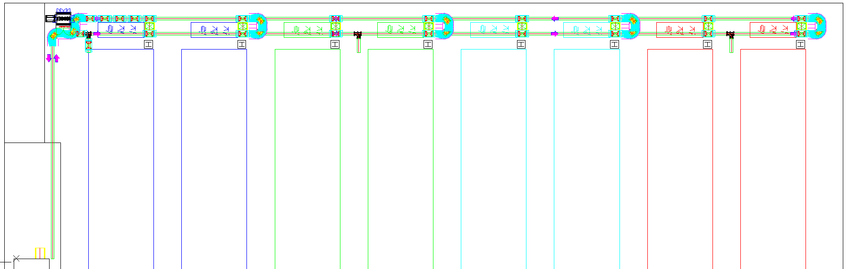
GENERAL DESCRIPTION
1-2. VEHICLE ROUTE & CYCLE TIME
■ LEFT RAIL CONFIGURATION
VEHICLE 운영 (권취 + 조립)
-. Operation 2 Set / Charging 1 Set
Work Lifter ( 8 Ports )
MTL
Charging Branch ( 1 Port )
Maintenance Branch ( 2 Port )
Work 회수 Line
Work 공급 Line
자재 STK (1Port)
회귀 구간

Slide 8
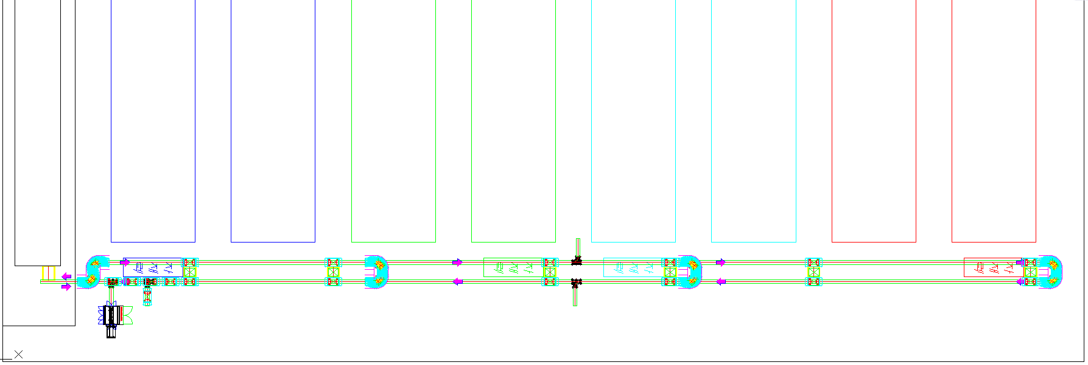
GENERAL DESCRIPTION
1-2. VEHICLE ROUTE & CYCLE TIME
■ RIGHT RAIL CONFIGURATION
VEHICLE 운영 (권취 + CAN)
-. Operation 3 Set / Charging 1 Set
회귀 구간
Work 공급 Line
Work 회수 Line
Maintenance Branch ( 2 Ports )
Work Lifter Can 전용 ( 2 Ports )
자재 STK ( 1Ports )
MTL
Charging Branch ( 1 Port )
Work Lifter ( 4 Ports )

Slide 9
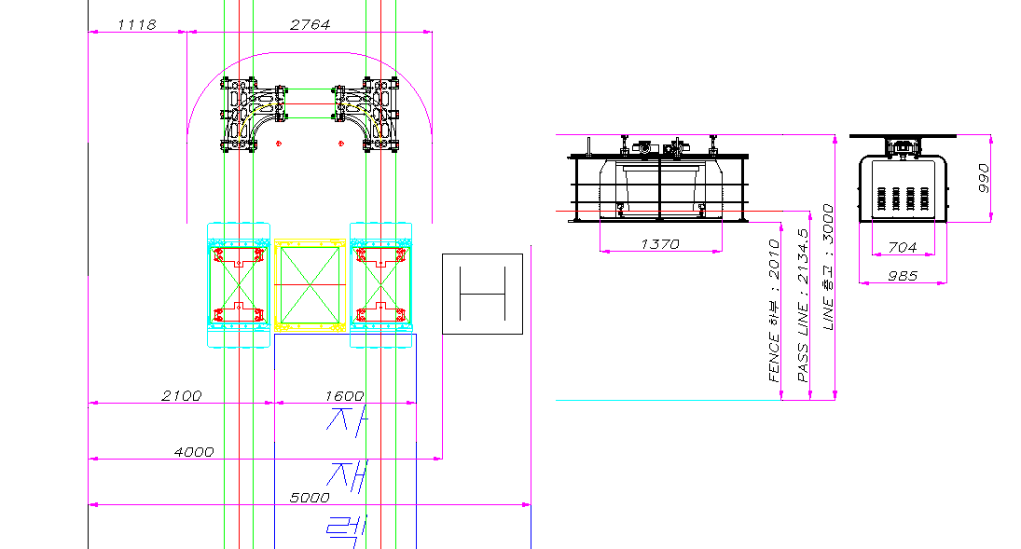
GENERAL DESCRIPTION
1-2. VEHICLE ROUTE & CYCLE TIME
■ RAIL CONCEPT & VEHICLE POSITION
OHV RAIL CONCEPT & VEHICLE 상공위치
-. VEHICLE PASS LINE : 2,135mm
Tray 공급
Work Lifter
Tray 회수

Slide 10
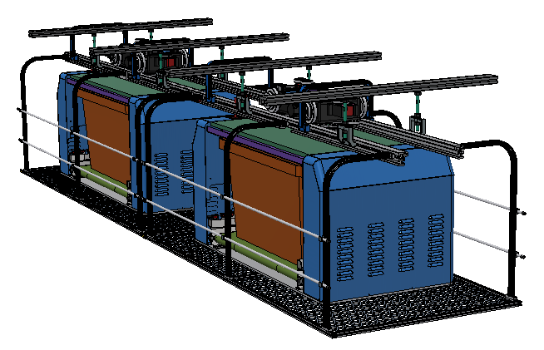
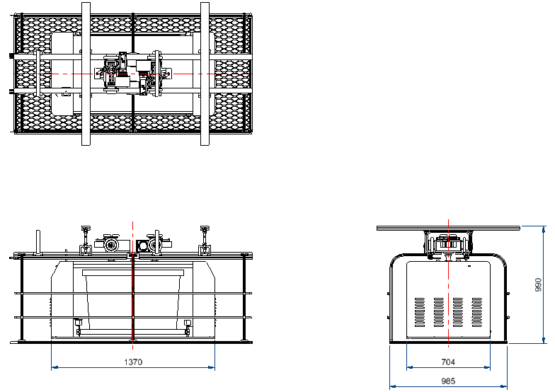
SYSTEM CONFIGURATION
2-1. OHV SYSTEM CONFIGURATION
VEHICLE RAIL
■ Layout & Unit Configuration
YOKE
CEILING SUPPORT
VEHICLE
SAFETY FENCE

Slide 11
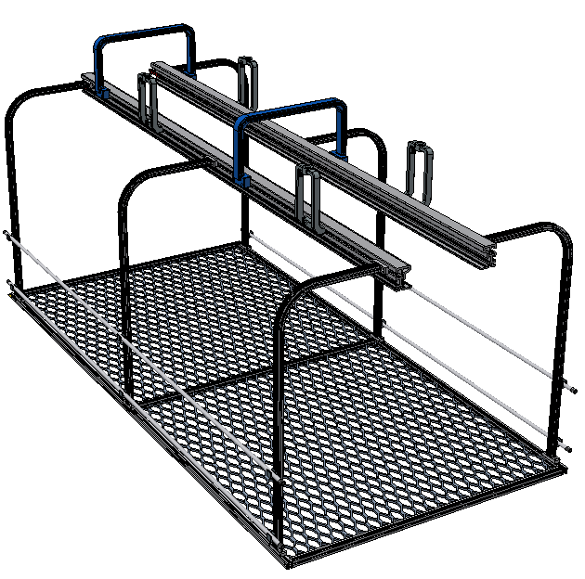
SYSTEM CONFIGURATION
2-1. OHV SYSTEM CONFIGURATION
■ Rail & Safety Fence Unit (Concept)
DESCRIPTION | SPECIFICATION | REMARK
RAIL & SAFTY FENCE | Driving Rail : AL6061 압출 Profile
 | Parallel Rail 고정 Support : Standard Yoke
 | Ceiling Support : AL6061 사출품
 | Safty Fence : SUS Pipe & Mesh 망
OHT Rail(압출 Profile)
Parallel Rail 고정 Support
Ceiling Support
※ Straight Rail Level (Flatness) : ± 0.2mm
Safty Fence SUS PIPE
Safty Mesh망

Slide 12
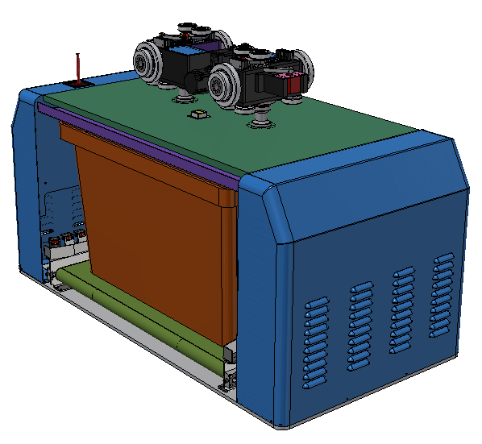
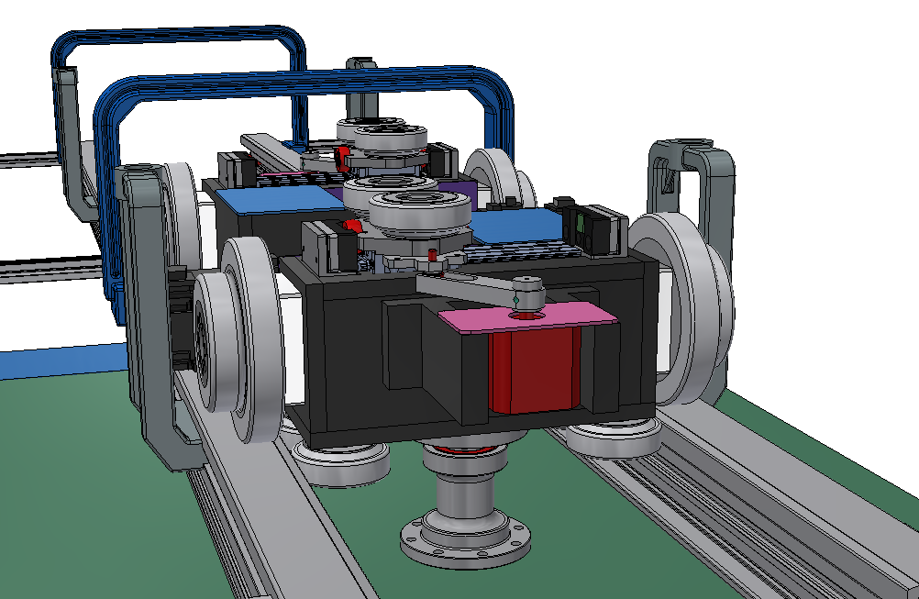
SYSTEM CONFIGURATION
2-1. OHV SYSTEM CONFIGURATION
■ OHV Vehicle Unit (Concept)
Servo Motor
(2개소)
DESCRIPTION | SPECIFICATION | REMARK
VEHICLE | Driving Method : Servo Motor & Wheel
 | Driving Speed : Straight, Max. 3,000 mm/sec | User Spec.
 | Driving Speed : Curve, Max. 580 mm/sec
 | Acceleration (Deceleration) Speed : 1m/sec²
 | Vehicle Guide Roller : Urethane
 | Wheel Steering Unit : Installed
 | Corner Driving Differential : Wheel 개별 구동
Tray 투입 & 배출
Driving Wheel
Tray 이송 Conveyor
Rail Guide Roller
※ Drive Wheel 교체주기 : 6개월 내 (PM 주기)
DIRECTION

Slide 13
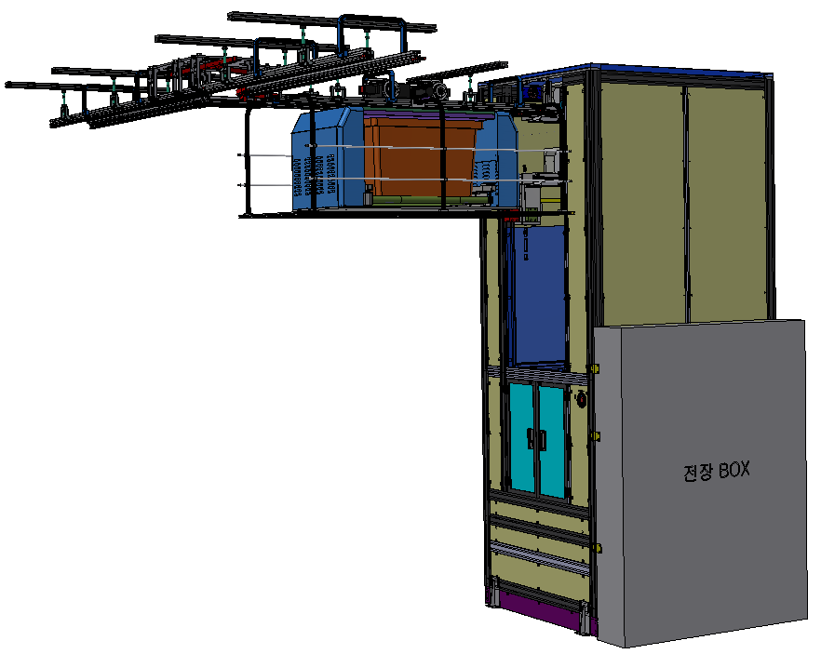
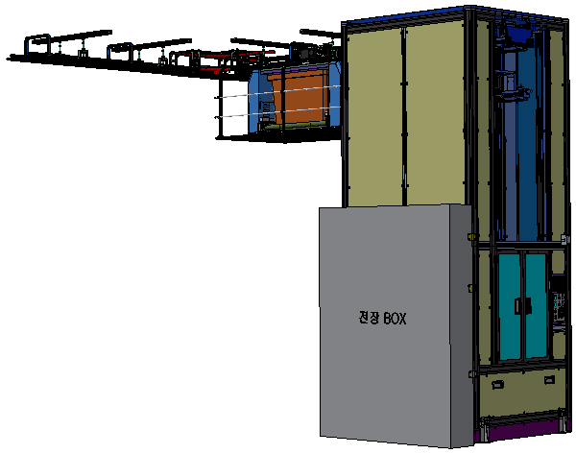
SYSTEM CONFIGURATION
2-2. MAINTENANCE VEHICLE LIFTER (CONCEPT)
VEHICLE 투입 & 배출
VEHICLE 투입 & 배출

Slide 14
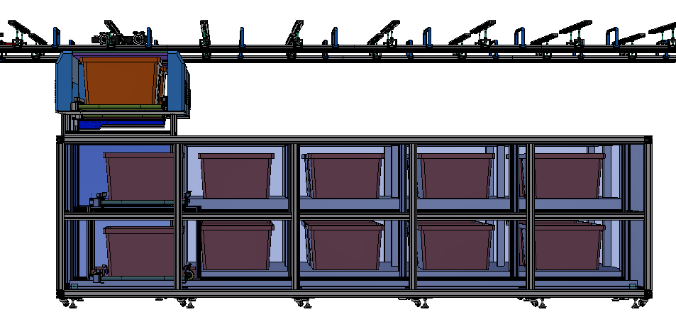
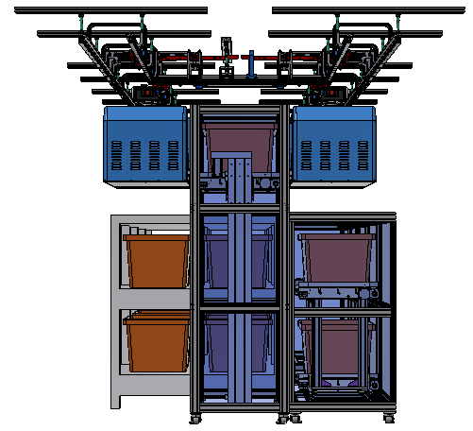
SYSTEM CONFIGURATION
2-3. WORK LIFTER & WORK SHUTTLE (CONCEPT)
Tray 공급
Tray 회수
Work Shuttle
Work Lifter

Slide 15
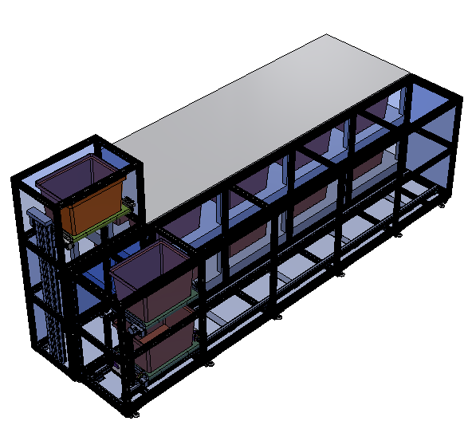
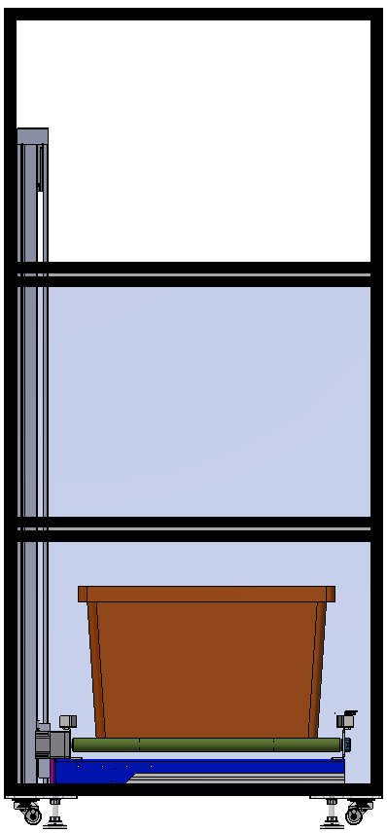
SYSTEM CONFIGURATION
2-3. WORK LIFTER & WORK SHUTTLE (CONCEPT)
Work Rack
DESCRIPTION | SPECIFICATION | REMARK
Work Shuttle | Driving Method : Y Axis Servo Motor
 | 투/배출 Conveyor : Induction Motor | 2 Set
Work Lifter | Driving Method : Z Axis Servo Motor
 | 투/배출 Conveyor : Induction Motor | 1 Set
Work Lifter <->Vehicle 투/배출
( Work 공급 및 회수)
Work Lifter ->Work Shuttle 배출
( Work 공급)
공급 Work 물류
회수 Work 물류
Work Lifter <- Work Shuttle 투입
( Work 회수)

Slide 16
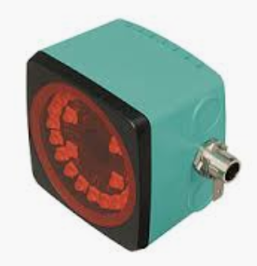
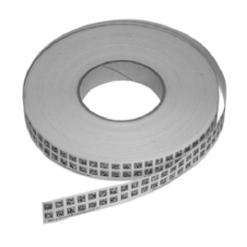
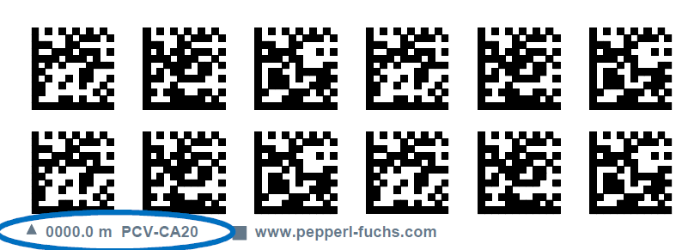
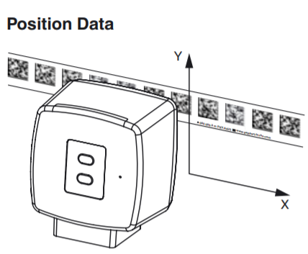
SYSTEM CONFIGURATION
2-4. DATA MATRIX POSITIONING SYSTEM
■ QR BAR CODE READER
DESCRIPTION | SPECIFICATION | REMARK
OPTICAL READING HEAD | Passage Speed : v ≤ 8m/s
 | Measuring Range : Max 10000m
 | Light Type : Integrated LED Lightning (red)
 | Scan rate : 40 s-1
 | Read distance : 100 mm
 | Depth of focus : ± 50 mm
 | Reading field : 115 mm x 73 mm
 | Ambient light limit : 100000 Lux
 | Accuracy : ± 0.2 mm

Slide 17
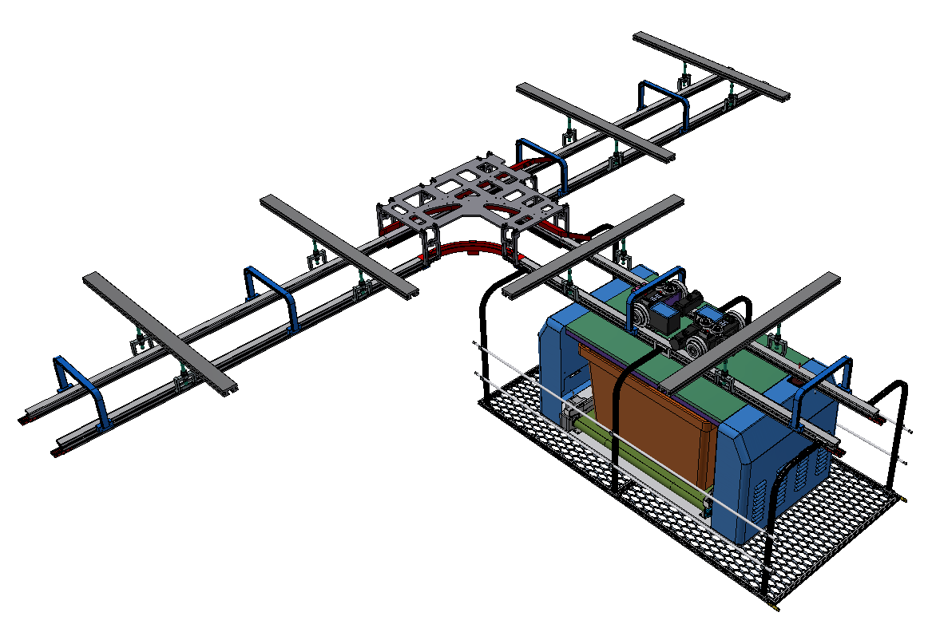
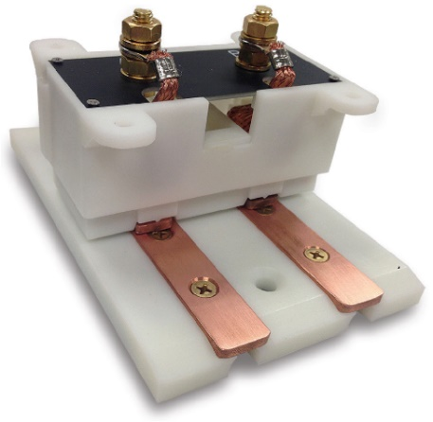

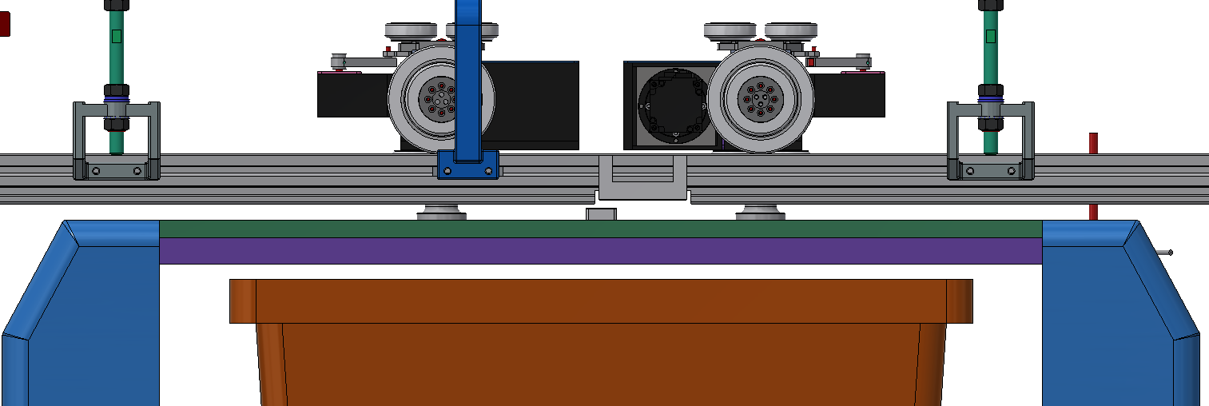
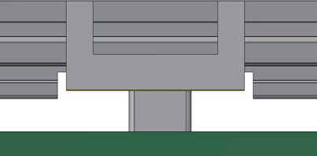
SYSTEM CONFIGURATION
2-5. CHARGING STATION & COLLECTOR
■ CHARGING STATION
■ CHARGING BASE & COLLECTOR (MAKER : ROBOTEQ)
※ MAGNET을 이용하여,
VEHICLE 정 위치 시
COLLECTOR CONTACT
COLLECTOR
CHARGING BRANCH
CHARGING BASE
CHARGING STATION
RAIL
▶ VEHICLE 진입 시
CHARGING BASE
N S N
CHARGING BASE & COLLECTOR
N
COLLECTOR
▶ VEHICLE 정위치 시
N S N
N

Slide 18
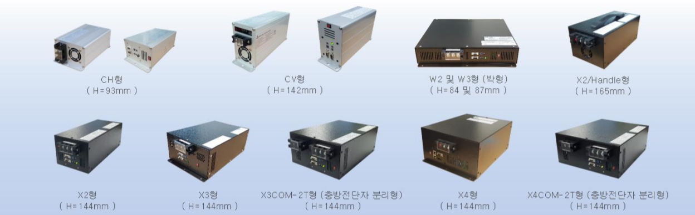
SYSTEM CONFIGURATION
2-6. POWER SUPPLY UNIT
■ VEHICLE BATTERY
BATTERY 선정조건 1) VEHICLE MOVING SPEED -. Straight Moving Speed : Max. 180m/min (3,000mm/sec) -. Curve Moving Speed : Max. 35m/min (583mm/sec) -. Acceleration (Deceleration) Speed : 1m/sec2 (0.1G) 2) VEHICLE 가동률 -. 가동시간 : 4Hr (완충 후 운영 가능 시간) -. 충전시간 : 2Hr (완충 소요 시간) -. 가동률 : 4/(4+2)*100 = 67% ( 수시충전 포함 )
선정 BATTERY & CHARGER 1) BATTERY : 25V, 1320Wh 2) CHARGING UNIT : 700W-25V25A

Slide 19
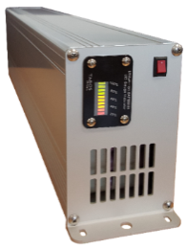
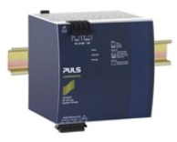
SYSTEM CONFIGURATION
2-6. POWER SUPPLY UNIT
■ BATTERY 기본 운영
-. RS-232/485 통신 기능 내장 형 BATTERY 사용 → BATTERY 상태 MONITORING 가능.
-. BATTERY 잔량이 일정 수준 이하인 경우, 운행을 중지하고 자동으로 충전 시작 (충전 위치로 이동)
※ BATTERY 운영시간을 연장을 위해서, 충전 위치 외에, 대기위치상에서도 수시충전
■ BATTERY 방전 시 대책
-. AGV 내부 BACK-UP BATTERY 를 별도 설치하여, MAIN BATTERY 방전 시 단 시간 동안 BACK-UP BATTERY로
AGV 운영 (충전 STATION 으로 이동)
-. PORTABLE 보조 BATTERY 를 이용한 전원공급
※ 보조 BATTERY 이용한 VEHICLE 이동 시 편의성을 위한 MCU 기본 제공
BATTERY 충전시
정상 운영시
MAIN BATTERY 방전시
MAIN BATTERY
POWER
MAIN BATTERY
MAIN BATTERY
POWER
평상시
AGV 구동 회로
평상시
AGV 구동 회로
평상시
AGV 구동 회로
BACKUP BATTERY
POWER
BACKUP BATTERY
BACKUP BATTERY
POWER
MAIN BATTERY
AGV 구동 회로
MAIN BATTERY
AGV 구동 회로
MAIN BATTERY
AGV 구동 회로

Slide 20

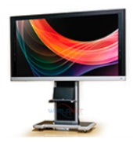

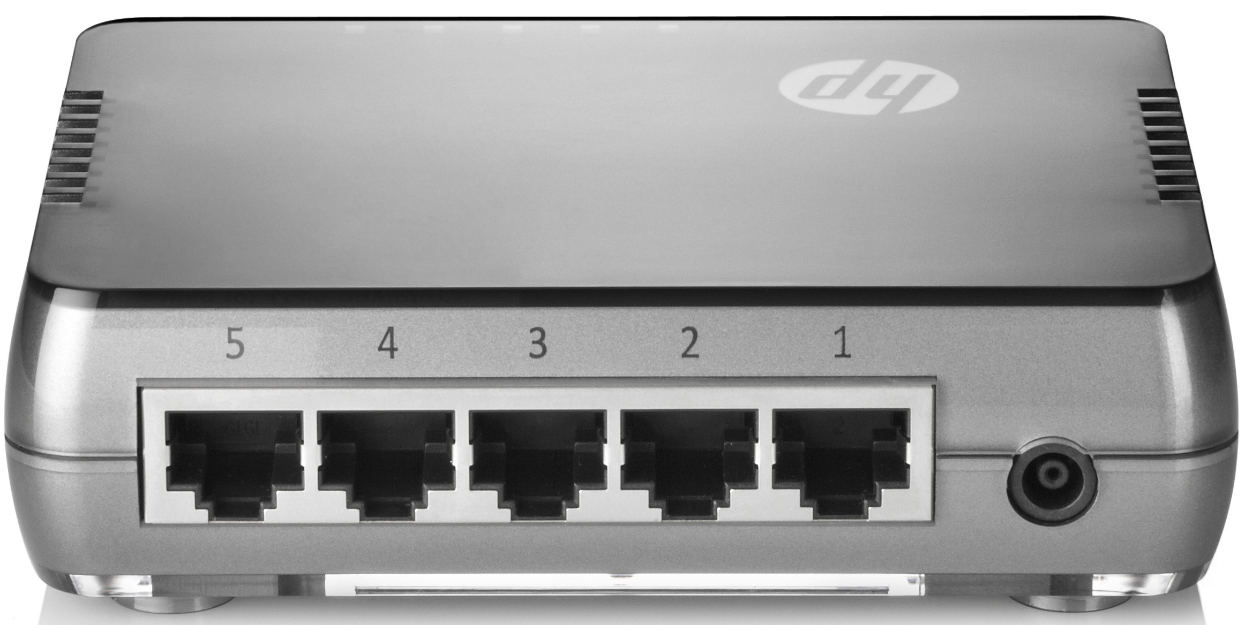
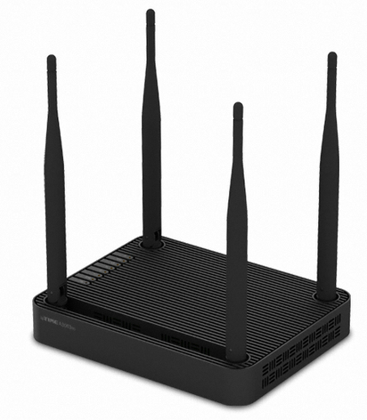

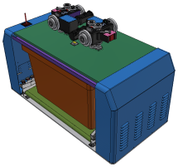

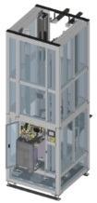

SYSTEM CONFIGURATION
2-7. ON-LINE SYSTEM CONFIGURATION
ADS (TC)
※ OCS (OHV Control System) : OHV System을 운영하기 위한 물류제어 Software.
※ HUB : Network를 구성하기 위해 OCS운영 PC와 OHV System 장치들을 LAN에 접속시키는 공유장치.
※ AP (Access Point) : OCS운영PC와 OHV간의 통신을 위한 무선 LAN 안테나.
ETHERNET
OHV SYSTEM
OCS &
MONITORING SYS.
MAIN CONTROLLR
HUB
CC LINK IE
MAIN PLC
AP
ETHERNET
ETHERNET
WIRELESS
VEHICLE
MTL(LIFTER)
WORK LIFTER (PORTS)

Slide 21
UTILITY SPECIFICATION
3. UTILITY SPECIFICATION
■ VEHICLE POWER SUPPLY (BATTERY)
Utility | Usage | Size | Q’ty | Specification | Max. Volume | Material | Connection
Air | Operation | ½” | 1 | 0.55 ~ 0.6 Mpa | 250 NLPM | SUS Tube | ½” LOK Fitting
Power (GPS) | 3PH 220VAC, 50/60Hz, 8.6 KVA (23A) |  |  |  |  |  | Terminal Block
Power (UPS) | 1PH 220VAC, 50/60Hz, 1.1 KVA (5A)

Slide 22
감사합니다

